Slide 1


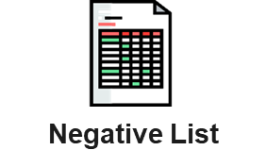


Fraud Screening (High-level Operating Model)
Branch Credit Operation (BO)
Fraud team-Local ERM staff
1
Check Negative List
ID no
Mobile phone no.
E-mail address
Pass
No
Reject App
Yes
2
Verify Document
Bank statement
Pay slip
Suspicious
Pass
Result
Investigation
Cross check income from bank statement
(Refer to Operation Handbook)
Yes
3
Check Fraud Score
Application (consistency)
Credit bureau (frequency)
History data (reject history)
No
Reject App
Pass
Reject Analysis
Fraud Score
Further explore reject reason
Improve fraud rule & score
Yes
Credit Approval Process
Notes:
Fraud screening ตาม 3 steps
ต้องมี CIC เราถึงมั่นใจว่าไม่ fraud
ช่วงแรกระวังไม่รับลูกค้าที่ไม่รู้จัก ต้องมีข้อมูลบูโร หรือ Partner

Slide 2

Application Fraud (ML)
Data_prep 1
Data_prep 2
Data_prep 3
Send Data Result
Data_prep 4
Main Input 1
Decision Engine
Main Input 2
Additional Input 3
Report
Additional Input 4

Slide 3





Application Fraud (ML) MVP stage
Application ID
National ID No.
Main occupation
Main occupation type
Company Employer
Estimated Income
Credit Approval Checker Result*
Credit Approval GD Result*
App_Date
Criminal_Email
Criminal_ID
Criminal_Phone
Fraud_DB
PII (FPT file) app-in
Decision Engine
* Approval result
CIC Report
Partner Data
Report
Bank Statement/Pay Slip

Slide 4
Fraud (ML) MVP Rule
Rule No. | Rule Code | Rule Description | Score | DB | Field
1 | X001USL | ID Number on Criminal Database | 900 | Criminal_ID | National ID No.
2 | H032USL | Email Address on Criminal Database | 900 | Criminal_Email | Email address
3 | H039USL | Mobile Phone on Criminal Database | 900 | Criminal_Phone | Phone number
4 | N005USL | Age >= 40 and No NCB account | 0 | - | Age, Rank (very good 1-10 bad)
5 | N011USL | Age >= 40 and Age of Earliest Credit Bureau Enquiry < 6 months | 0 | - | Age, Number of request in last 6 months
6 | N012USL | High frequency of credit request L6M (no. of requests >= 6) | 300 | - | Number of request in last 6 months
7 | C002USL | Current occupation is Business owner but previously applied as an employee Last 6 months | 200 | Fraud_DB | National ID No., App-in time, Main occupation
8 | I001USL | Individual (salary earner): Monthly Income Increase > 50% in the last 6 Months | 200 | Fraud_DB | National ID No., App-in time, Main occupation, Salary or monthly income of freelancer
9 | I049USL | Business Owner: Monthly Income Increase > 100% in the last 6 Months | 200 | Fraud_DB | National ID No., App-in time, Main occupation, Salary or monthly income of freelancer
10 | M015USL | Multiple Applications from Same Employer Last 6 Month (Matches >5) | 100 | Fraud_DB | Office name, App-in time, Main occupation
11 | VN00001 | Rejected at least 4 times in last 6 months | 300 | Fraud_DB | National ID No., App-in time

Slide 5



Data list for NG DB
Fraud Score
Criminal_Email
Criminal_ID
Criminal_Phone
* Update List Manually (Monthly)

Slide 6
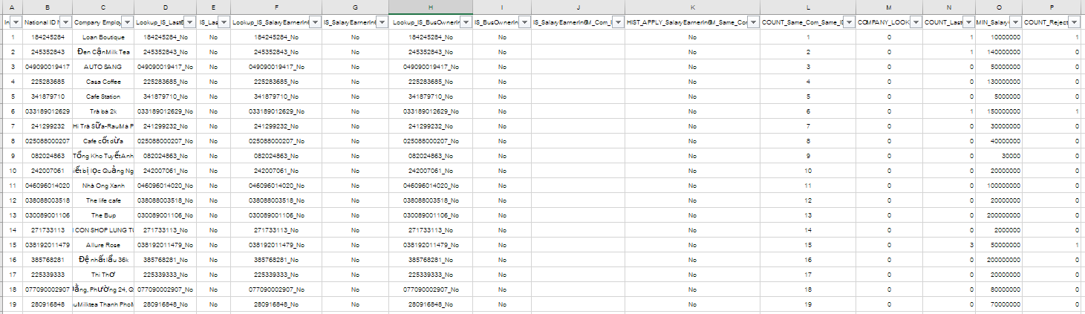
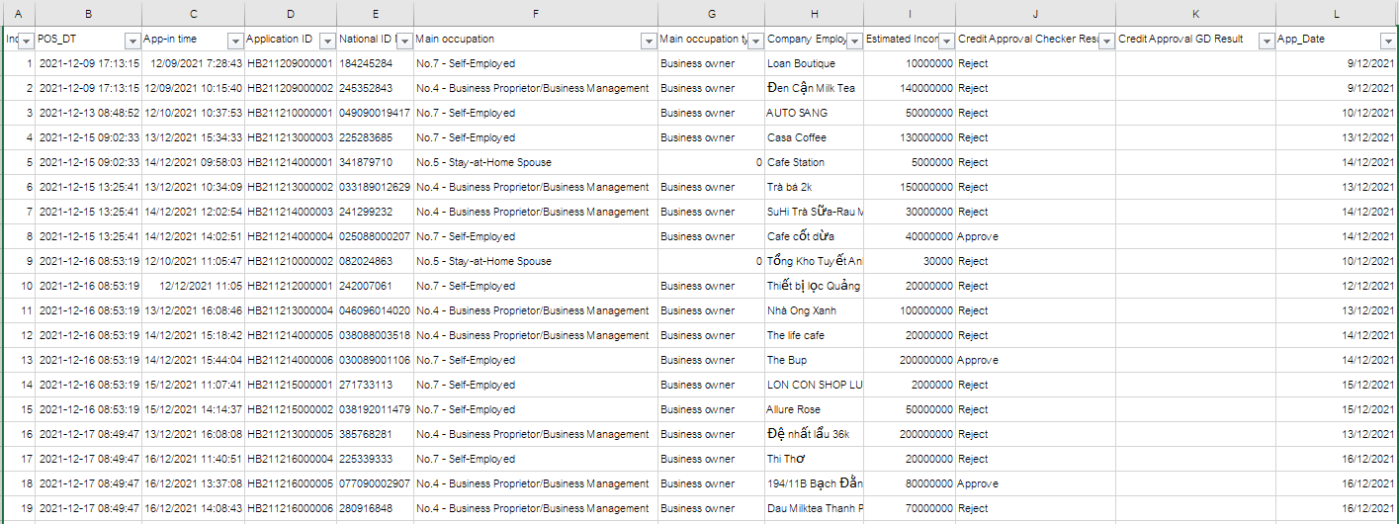
Fraud_DB
Fraud Score
Data Result from DE
Data for Fraud_DB check
Calculate in Excel
* Update Daily by EOD

Slide 7
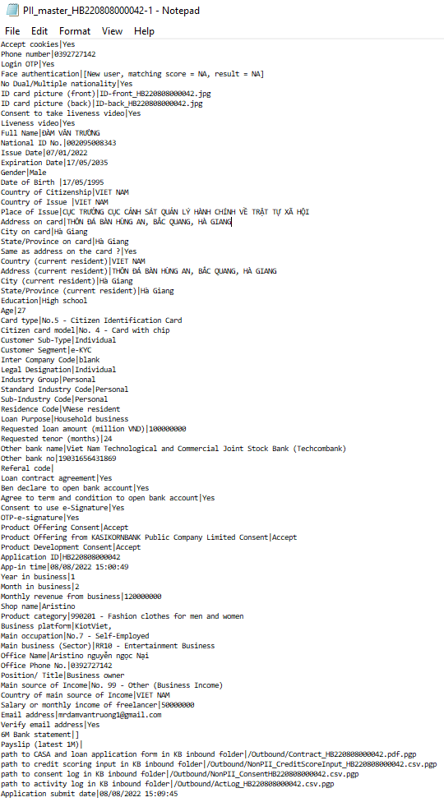
PII (FPT file) app-in
No. | Field Name
1 | National ID No.*
2 | Email address
3 | Phone number
4 | Age
5 | App-in time
6 | Main occupation
7 | Salary or monthly income of freelancer
8 | Office name
* Need to be verify by BO team in Decision Engine

Slide 8
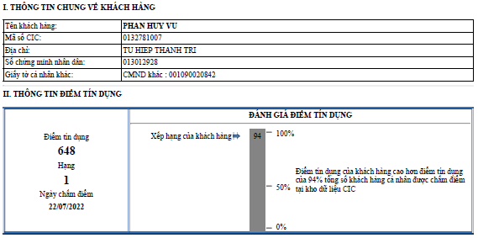
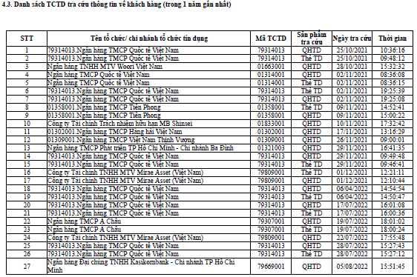
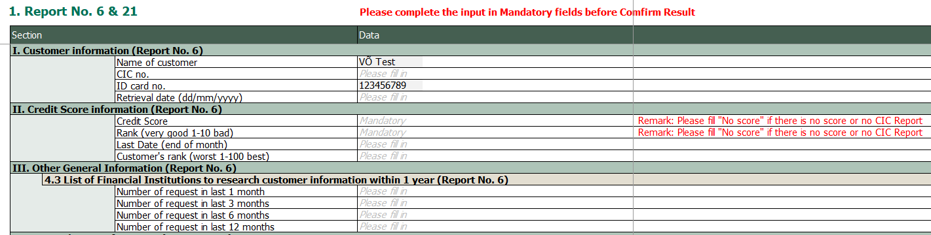
CIC Report
No. | Field Name
1 | Rank (very good 1-10 bad)*
2 | Number of request in last 6 months**
* Use to imply having NCB account or Not
** Need to be verify by BO team in Decision Engine
* QHTD = Report No.6 (Loan and General Information) The TD = Report No.21 (Card)

Slide 9
Main occupation type mapping (Business owner or Salary earner)
No. | Variable | Value
1 | No.1 - Government Officer | Salary earner
2 | No.2 - State Enterprise Employee | Salary earner
3 | No.3 - Private Enterprise Employee | Salary earner
4 | No.4 - Business Proprietor/Business Management | Business owner
5 | No.5 - Stay-at-Home Spouse
6 | No.6 – Student
7 | No.7 - Self-Employed | Business owner
8 | No.8 – Farmer | Business owner
9 | No.9 - Hired Worker | Salary earner
10 | No.10 - Monk/ Priest
11 | No.11 – Retiree
99 | No.99 - Others (Please Specify)

Slide 10
Fraud (ML) MVP Rule
Rule No. | Rule Code | Rule Description | Score | DB | Field
1 | X001USL | ID Number on Criminal Database | 900 | Criminal_ID | National ID No.
2 | H032USL | Email Address on Criminal Database | 900 | Criminal_Email | Email address
3 | H039USL | Mobile Phone on Criminal Database | 900 | Criminal_Phone | Phone number
4 | N005USL | Age >= 40 and No NCB account | 0 | - | Age, Rank (very good 1-10 bad)
5 | N011USL | Age >= 40 and Age of Earliest Credit Bureau Enquiry < 6 months | 0 | - | Age, Number of request in last 6 months
6 | N012USL | High frequency of credit request L6M (no. of requests >= 6) | 300 | - | Number of request in last 6 months
7 | C002USL | Current occupation is Business owner but previously applied as an employee Last 6 months | 200 | Fraud_DB | National ID No., App-in time, Main occupation
8 | I001USL | Individual (salary earner): Monthly Income Increase > 50% in the last 6 Months | 200 | Fraud_DB | National ID No., App-in time, Main occupation, Salary or monthly income of freelancer
9 | I049USL | Business Owner: Monthly Income Increase > 100% in the last 6 Months | 200 | Fraud_DB | National ID No., App-in time, Main occupation, Salary or monthly income of freelancer
10 | M015USL | Multiple Applications from Same Employer Last 6 Month (Matches >5) | 100 | Fraud_DB | Office name, App-in time, Main occupation
11 | VN00001 | Rejected at least 4 times in last 6 months | 300 | Fraud_DB | National ID No., App-in time

